Slide 1
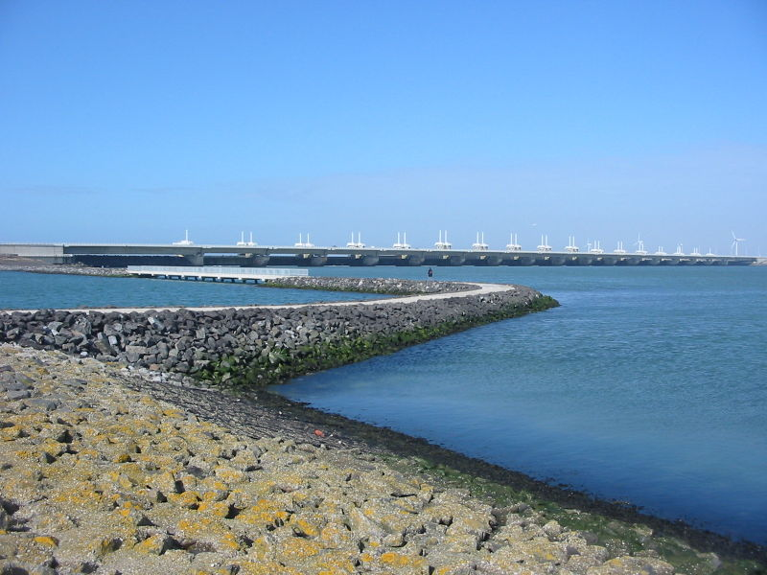
Coastal Management Information
By Maison Roberts

Slide 2
What Is Coastal Management
Coastal management is defence against flooding and erosion, and techniques that stop erosion to claim lands.
Coastal zones occupy less than 15% of the Earth's land area, while they host more than 45% of the world population. Nearly 1.4 billion people live within 100 km of a shoreline and 100 m of sea level, with an average density 3 times higher than the global average for population. With three-quarters of the world population expected to reside in the coastal zone by 2025, human activities originating from this small land area will impose heavy pressure on coasts. Coastal zones contain rich resources to produce goods and services and are home to most commercial and industrial activities.

Slide 3
Why do we need Coastal Management
Coastal management is important for a variety of reasons: Most countries create a large amount of revenue from tourism, and a majority of this tourism can be contributed to the coastline. Tourism is the commercial flow of people to a destination for purposes of sightseeing, recreational and other leisure activities

Slide 4
What types of Coastal Management is there?
There are two types of coastal management: Hard engineering - this involves building structures to protect the coast. Soft engineering - this involves working with nature by using natural materials or allowing nature to take back areas.

Slide 5
Methods of Coastal Managements
Hard Engineering:
Sea Walls
Coastal Barrages
Rock Armour
Groynes
Soft Engineering:
Beach nourishment
Managed Retreat

